Slide 1
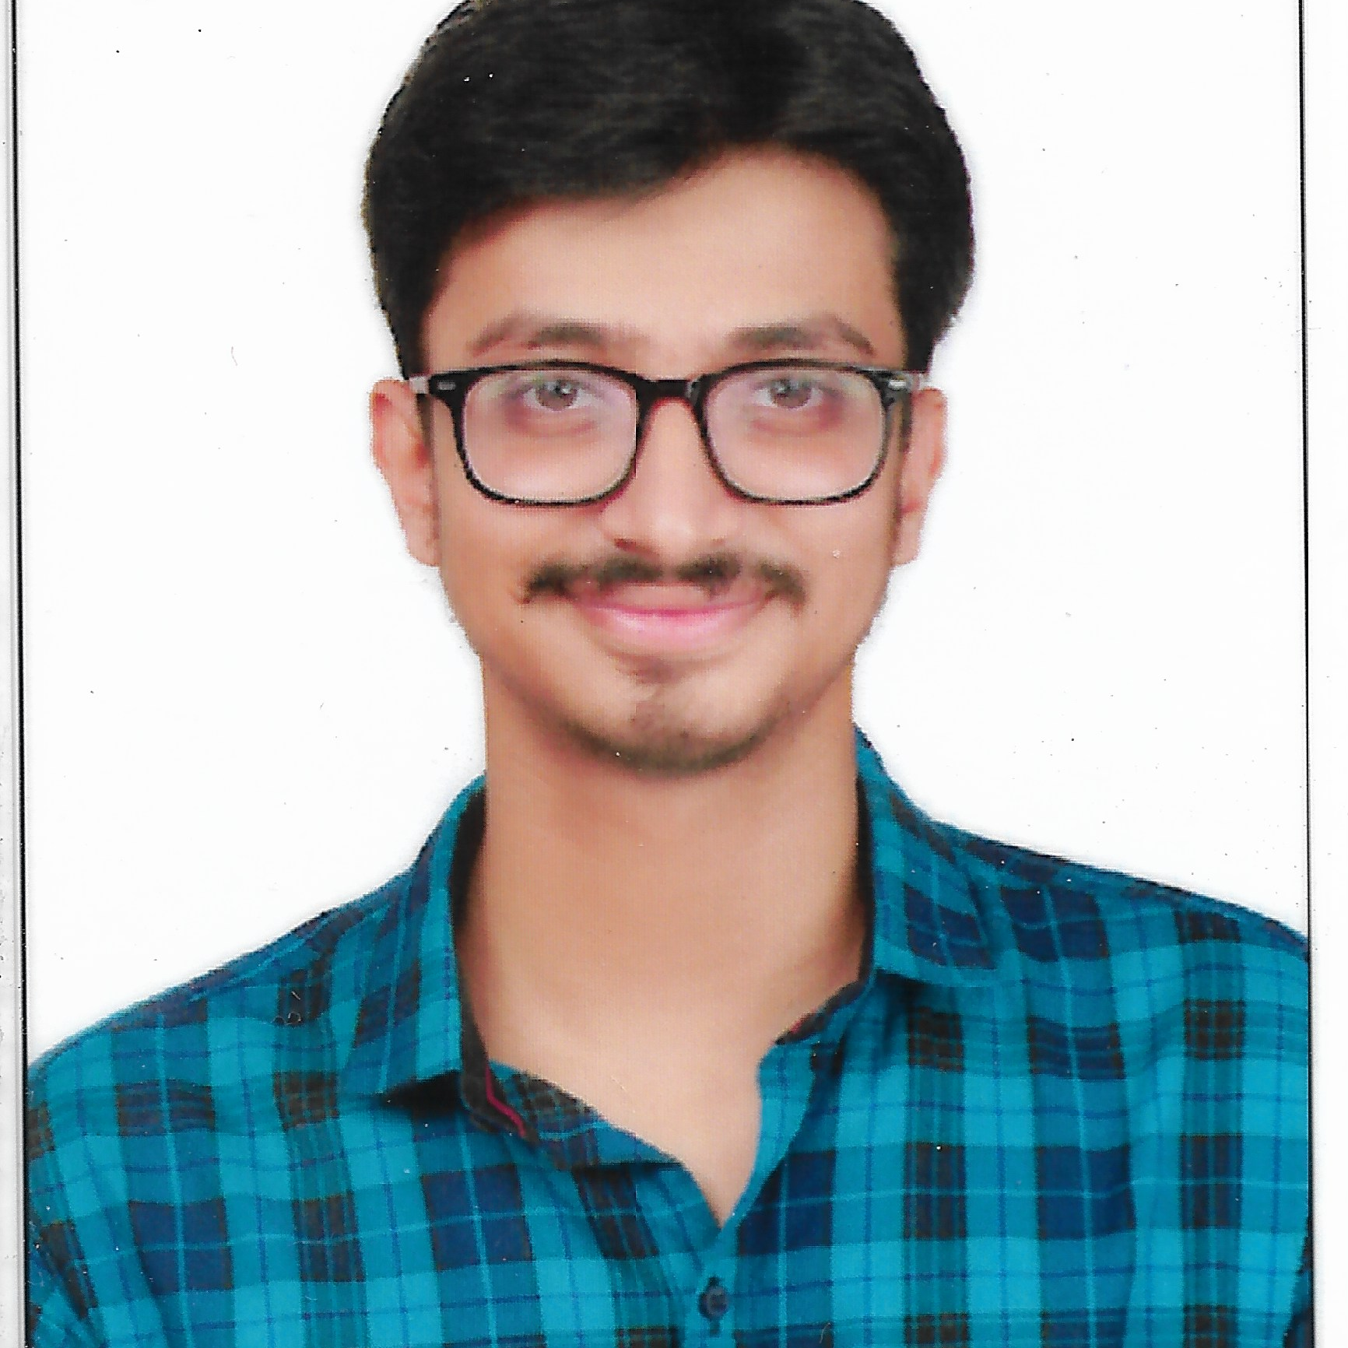



Rahul Ramkrishna Patil
Analyst/Software Engineer
Bachelor of Engineering
Mechanical : 2016-2020
Skills
Java 8 /J2EE | Java Basics, OOPS, Generics, Collections, Arrays, Loops, Lambda Exp, Stream API Junit
Spring core | IOC & Dependency Injection, Autowire
Spring REST | REST controllers, Implementation of GET, POST, PUT & DELETE, Bean Validation & Exception Handling, Testing Services, Controller & Repository layer
Spring Data JPA | Implement DAO layer using spring Data repositories, Transaction Management
React | Components, Hooks, Event handling, Redux
Database | MongoDB No Sql Basics My SQL RDS Basics, Postgres SQL
UI Tech | HTML 5 & CSS 3,JavaScript, ES6 & TypeScript
Tools | Git, Postman, Maven, IDE
Add On skills | Communications, Team management. Peer learning
Mumbai
rahul.d.patil@capgemini.com
+91 9987596680
A4
Full Stack Developer
Proficient in creating Single page Web Application in React with Authentication
Hands on experience in developing web pages using HTML5, CSS3, Object Oriented Java script.
Currently improving skills on itransform-platform.
Having good knowledge on spring core, Spring MVC ,Spring boot.
Having knowledge about microservices.
Completed certification on AWS Certified Cloud Practitioner and GCP Digital Leader.
Online Railway Reservation System(Casestudy)
Created online Railway Reservation System which is used by the passenger to book tickets from one station to another. With the help of various microservices we made the backend and with the react we made the frontend
Agriculture Loan(Spring Project)
Created Agriculture loan application which is build to help customer to apply agriculture loans which is developed to automate all the activities of CRUD operation for loan ,documents and users through an application. We can create a system where we can manage all the information in a single place.
Note making system(React Project)
This application is built to help customer to keep their notes updated. User can save and delete the note and it is easy to use.
Check out my work on GitHub- https://github.com/itsmeRahul04

